Slide 1
General Information
Contact: christoph.karg@hpi.uni-potsdam.de
Exercise sessions: 13:30 – 15:00

Slide 2
General Information
Contact: christoph.karg@hpi.uni-potsdam.de
Exercise sessions: 13:30 – 15:00
There will be weekly pen-and-paper and programming exercises
You need at least 50% of the total points in the exercises to participate in the exam
The final grade is only based on the exam
The exam will take place in the first half of August (probably)

Slide 3
General Information
Group assignments are allowed up to 5 participants
Solutions to Pen&Paper exercises will be discussed in the session
Programming exercises will not be discussed
You’ll find solutions to the exercises on Moodle after the session
In case you still do not find your coding error please post a snapshot of your code + the error message in the Forum and ask for advice
Please help each other out ☺

Slide 4

Exercise 1 Recap: Regression and Gradient Descent

Slide 5
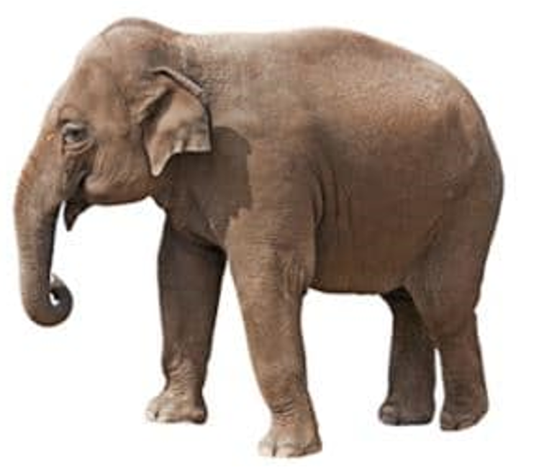
Example Scenario
Goal: Predict the age of an elephant
https://www.lorecentral.org/2019/05/what-are-the-differences-between-african-and-asian-elephants.html

Slide 6
Numerical data
Feature vector
Elephant
Features
Height
Weight
Trunk length
Ear size
Circumference
…
2.8
3853.7
0.8
1.5
1.9
…
https://www.lorecentral.org/2019/05/what-are-the-differences-between-african-and-asian-elephants.html

Slide 7
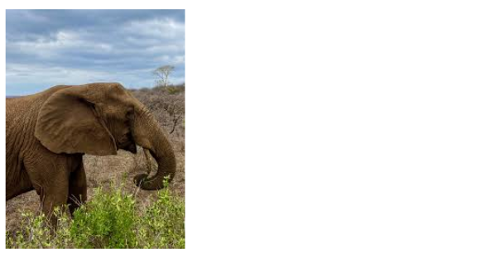
Image data
Elephant
image
Feature vector
?
https://www.kaggle.com/datasets/vivmankar/asian-vs-african-elephant-image-classification

Slide 8
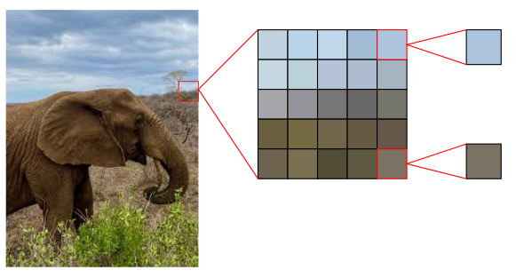
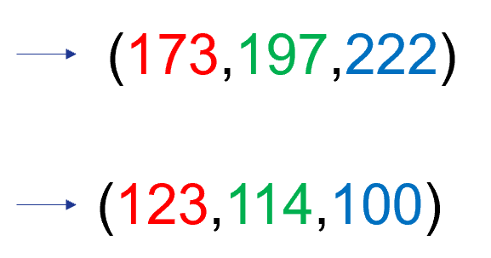
Image data
Elephant
image
Pixels
RGB values
https://www.kaggle.com/datasets/vivmankar/asian-vs-african-elephant-image-classification

Slide 9
Image data
Elephant
image
Pixels
RGB values
RGB values range from 0 to 255, stored as 8 Bit ints
A 100x100 image has 100*100*3 = 30 000 values (~ 30 KByte)
https://www.kaggle.com/datasets/vivmankar/asian-vs-african-elephant-image-classification

Slide 10
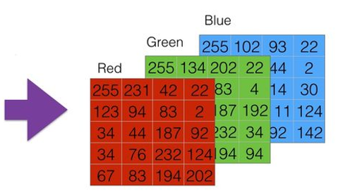
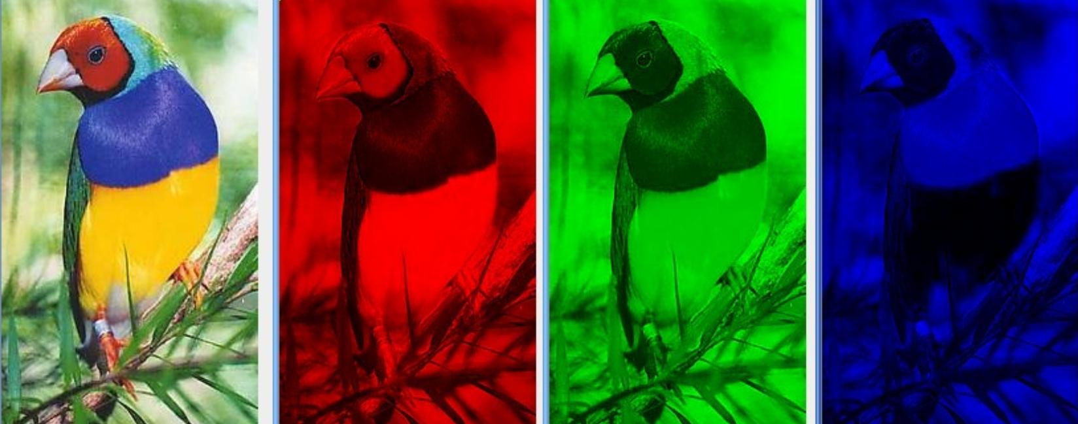
Image data – Color channels
Each image can be split up into its 3 color channels
Each color channel can be represented as a matrix (2D array) of size W x H
The whole image can be described as a tensor (3D array) of size W x H x C
https://www.bpesquet.fr/mlhandbook/fundamentals/handling_data.html

Slide 11
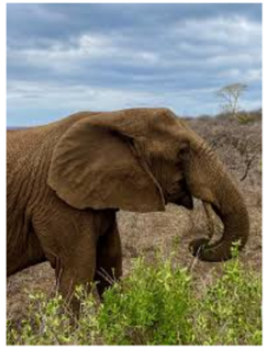
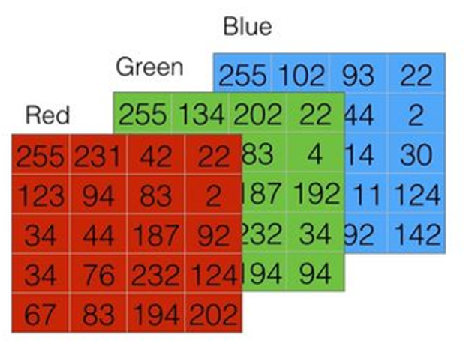
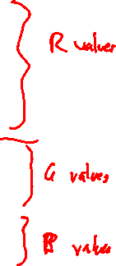
Image data
Elephant
image
Color channels
Elephant
image
Feature vector
255
231
41
22
123
…
https://www.kaggle.com/datasets/vivmankar/asian-vs-african-elephant-image-classification

Slide 12
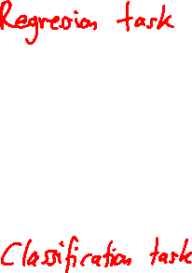
Regression tasks
Continuous numerical value
Example
Age: 3.7 years
Predict
255
231
41
22
123
…
Extract
Discrete category value
Example
African (0) vs Asian (1) elephant
Predict
https://www.kaggle.com/datasets/vivmankar/asian-vs-african-elephant-image-classification

Slide 13
Training data
Our training data consists of n instance pairs where
is the feature vector of the i-th instance, having length m
is the corresponding ground truth value, e.g. age or class index
We denote the i-th feature vector by where

Slide 14
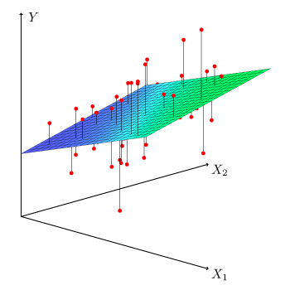
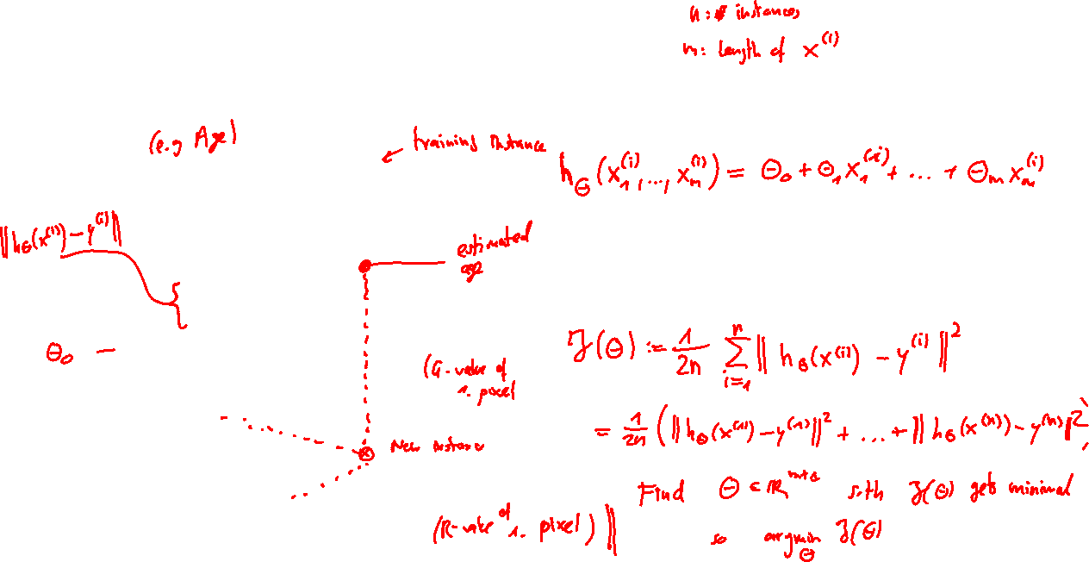
Linear regression
Model function:
Loss / cost function:
Mean squared error (MSE) loss
Goal:
https://statsandr.com/blog/multiple-linear-regression-made-simple/

Slide 15
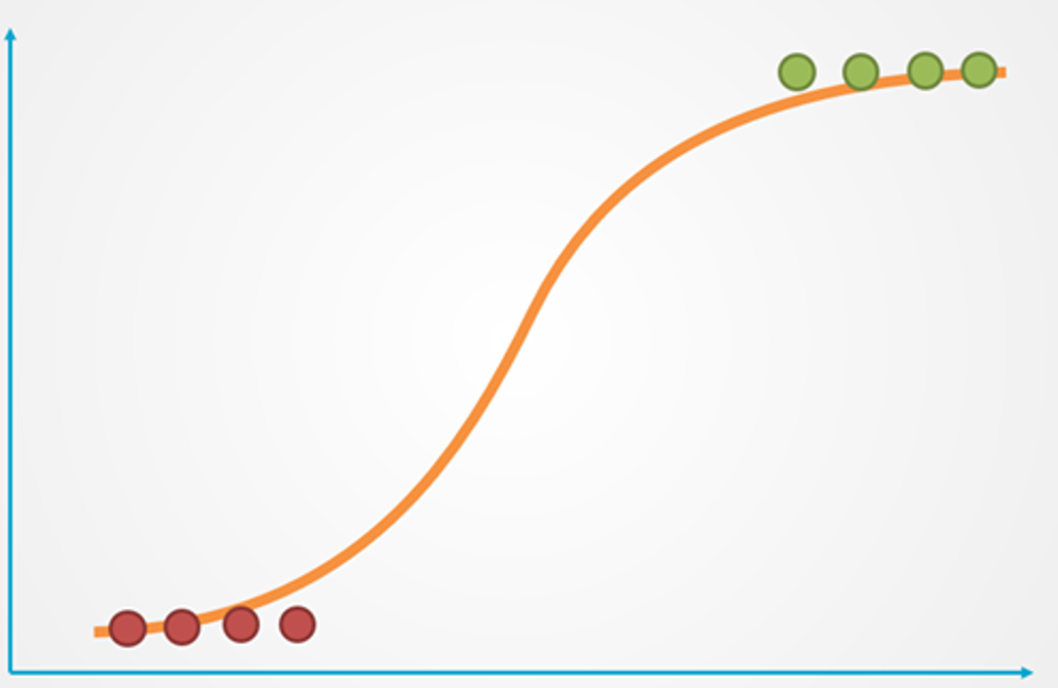
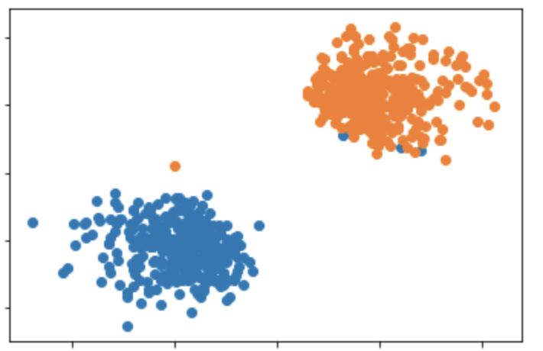
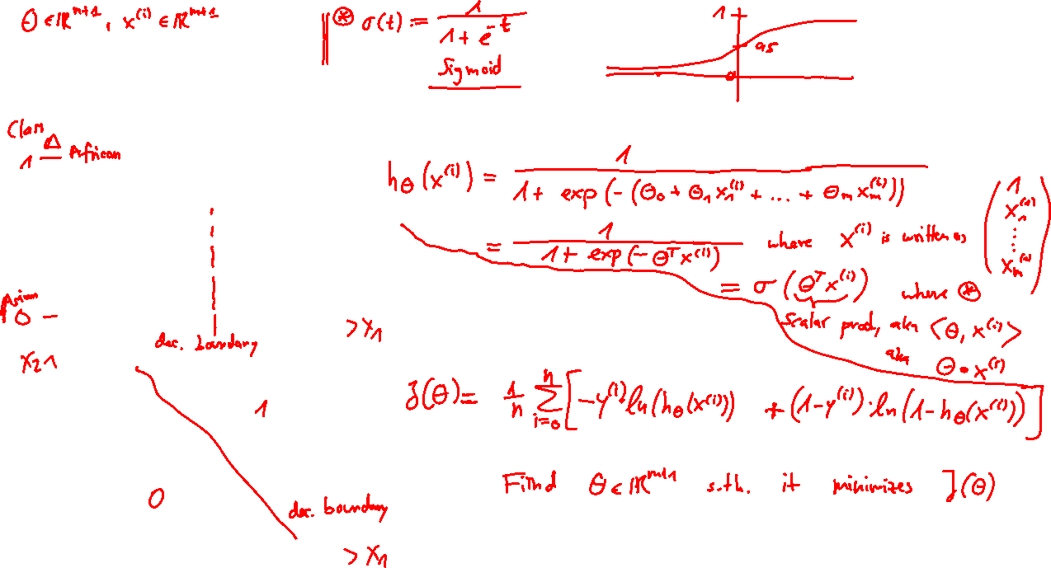
Logistic regression
Model function:
Loss / cost function:
Logistic loss (cross entropy loss)
Goal
https://towardsdatascience.com/logistic-regression-explained-in-7-minutes-f648bf44d53e

Slide 16
Machine Learning - Concept
Given n training data instances
Randomly initialized weights
Inputs
Estimates
Ground Truth
Model
function
Weight
update
Loss
Function

Slide 17
Machine Learning - Concept
Given n training data instances
Randomly initialized weights
Inputs
Estimates
Ground Truth
Model
function
Choose model based on scenario
Linear regression
Logistic regression
Neural Network
CNN
Etc.
Weight
update
Loss
Function

Slide 18
Machine Learning - Concept
Given n training data instances
Randomly initialized weights
Inputs
Estimates
Ground Truth
Model
function
Weight
update
Loss
Function
Gradient Descent

Slide 19
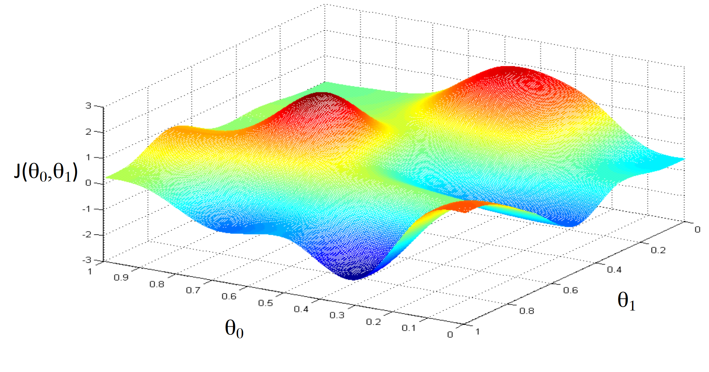
Gradient Descent algorithm
Goal: Find optimal weights that minimize the cost function
Credits to Andrew Ng (Stanford Machine Learning, 2017, cs229)

Slide 20
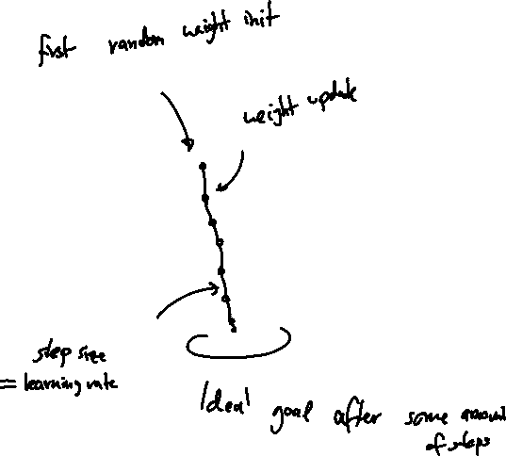
Gradient Descent algorithm
Goal: Find optimal weights that minimize the cost function
Step 1: Randomly initialize weights
Step 2: Update weights
Intuition: Take a step in direction of steepest descent (= gradient of J)
Credits to Andrew Ng (Stanford Machine Learning, 2017, cs229)

Slide 21
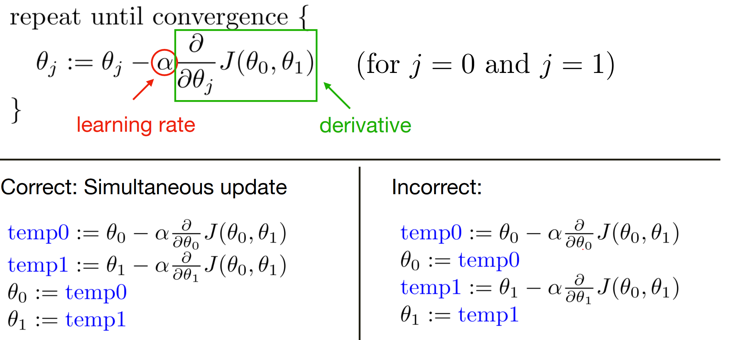
Gradient Descent algorithm
Credits to Andrew Ng (Stanford Machine Learning, 2017, cs229)

Slide 22
Gradient Descent algorithm
Problems / Outlook
Explicit formula of derivative often too complex -> Use Backpropagation
For large training data the weight update is slow -> Use Batch / Stochastic Gradient Descent
Credits to Andrew Ng (Stanford Machine Learning, 2017, cs229)

Slide 23
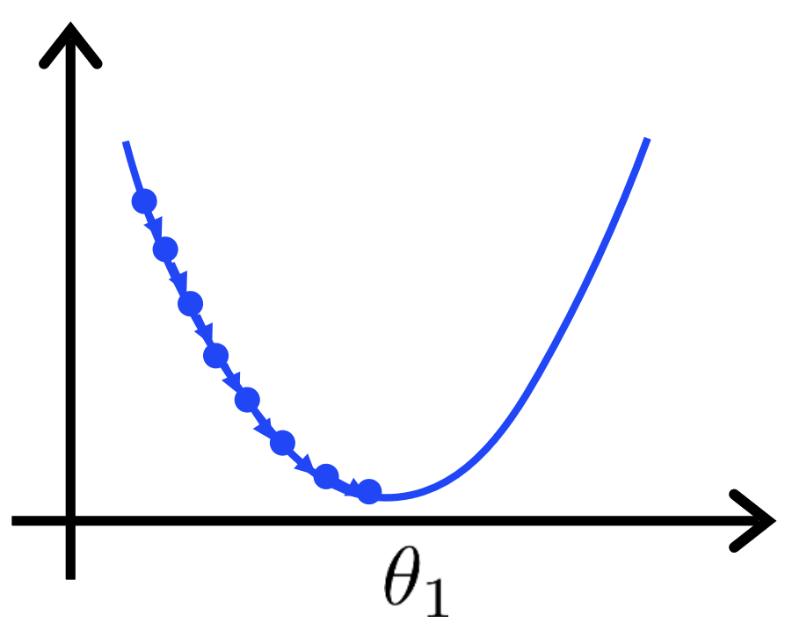
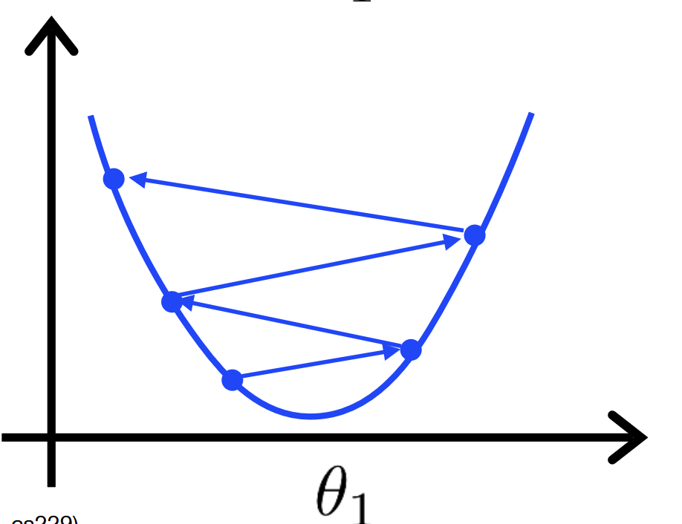
About the learning rate
The choice of the learning rate plays an important role for training the model
If it is set too small, then gradient descent will be very slow
If it is set too large, then gradient descent can overshoot the minimum. It may fail to converge, or even diverge.
Credits to Andrew Ng (Stanford Machine Learning, 2017, cs229)

Slide 24
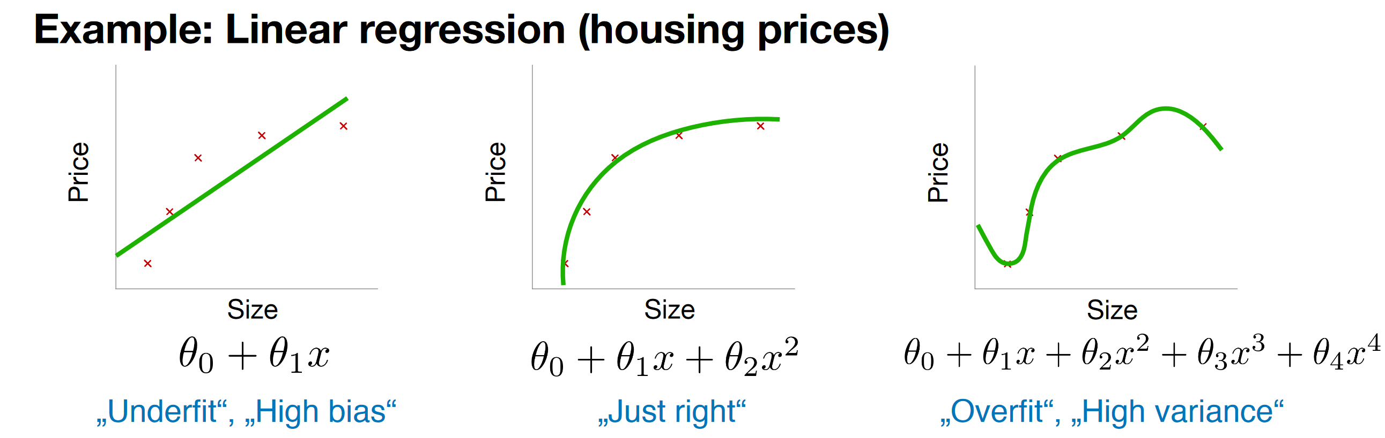
Over- vs Underfitting
Underfitting
If model not complex enough, it fails to capture more complex relations in the data
Overfitting
If model too complex, the learned hypothesis may fit the training set very well, but fail to generalize to new inputs
Credits to Andrew Ng (Stanford Machine Learning, 2017, cs229)

Slide 25
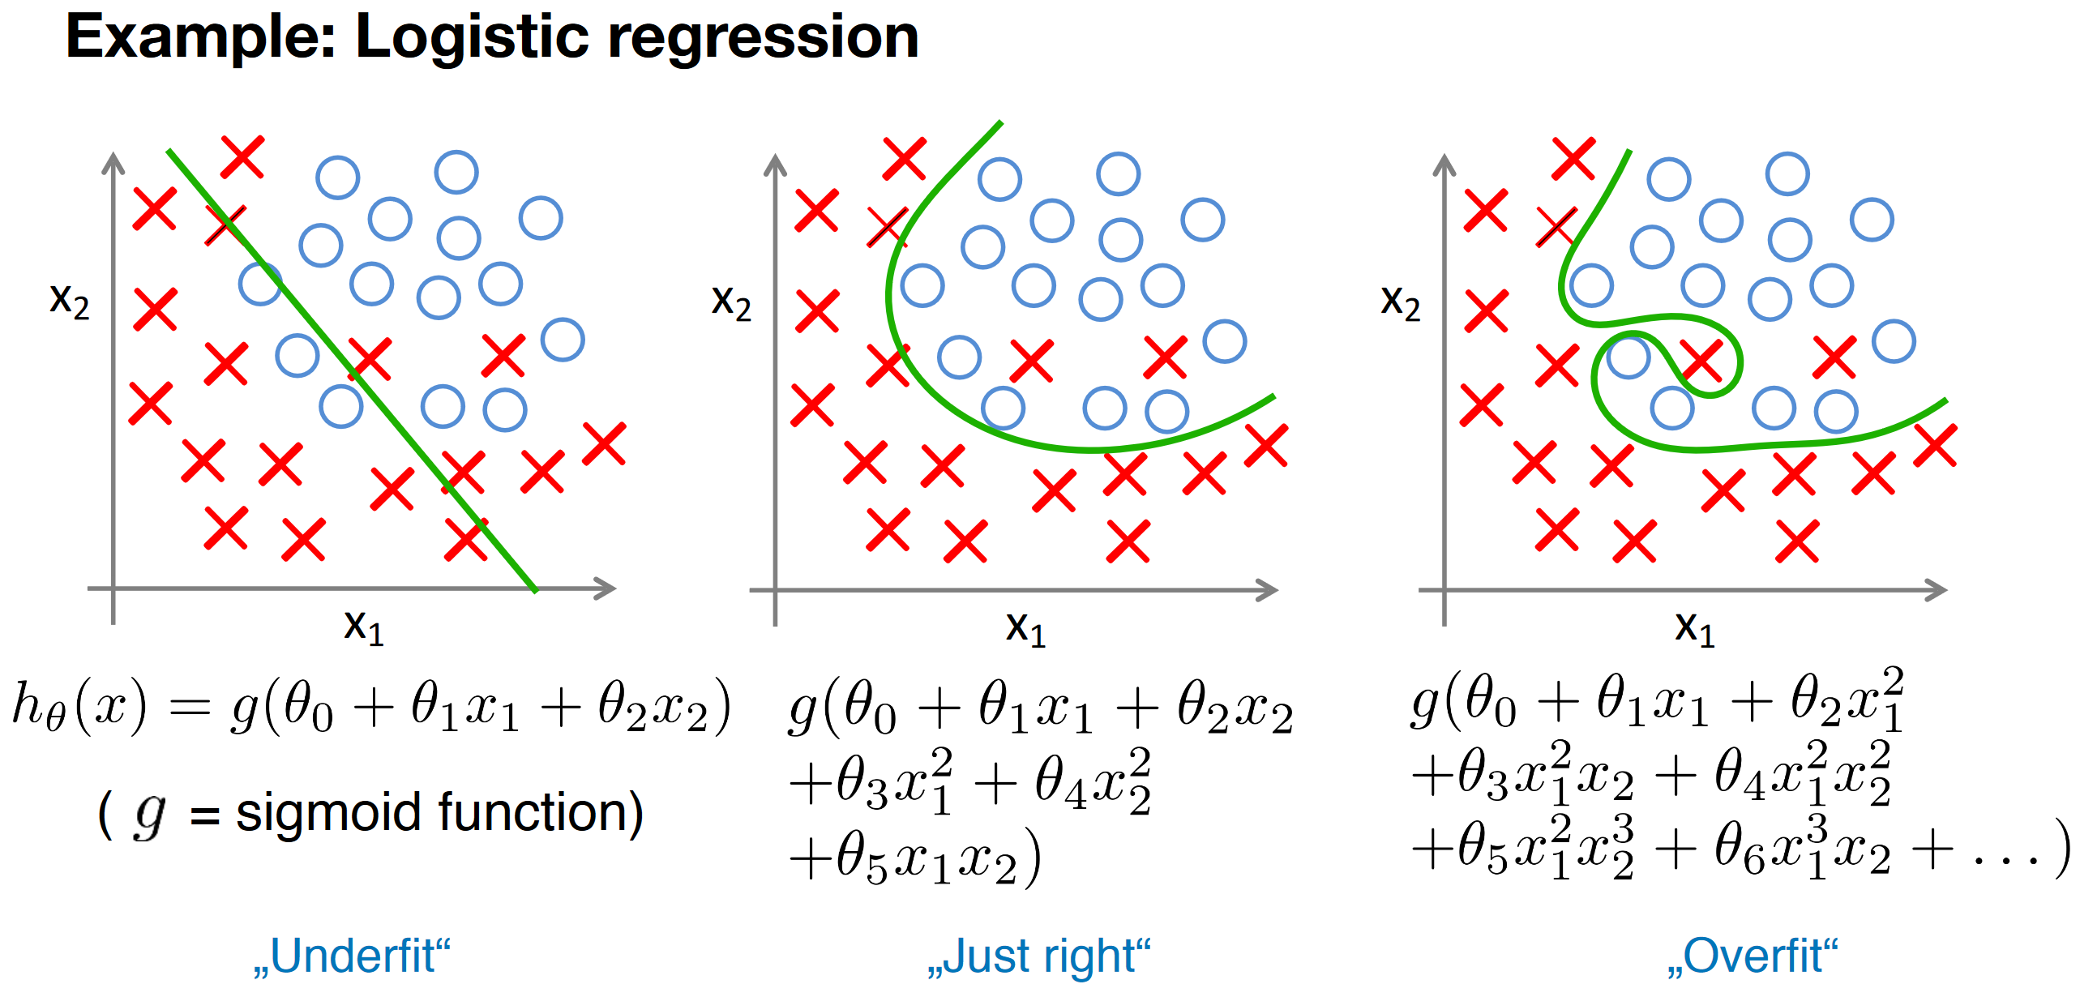
Over- vs Underfitting
Credits to Andrew Ng (Stanford Machine Learning, 2017, cs229)

Slide 26
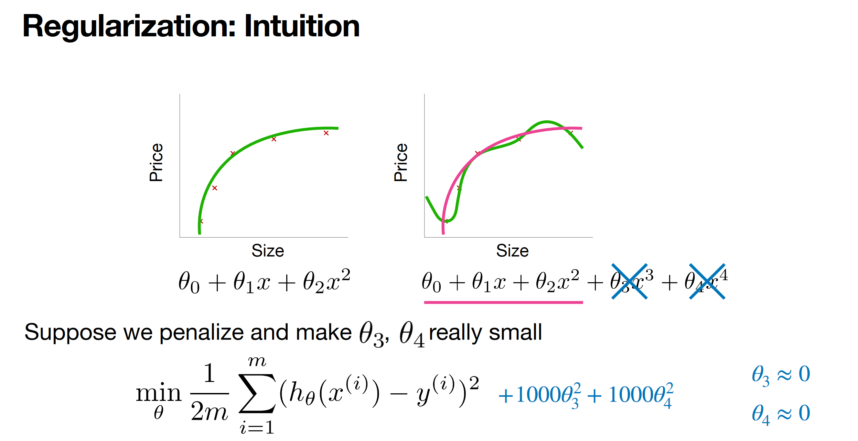
Regularization / Weight decay
Credits to Andrew Ng (Stanford Machine Learning, 2017, cs229)

Slide 27
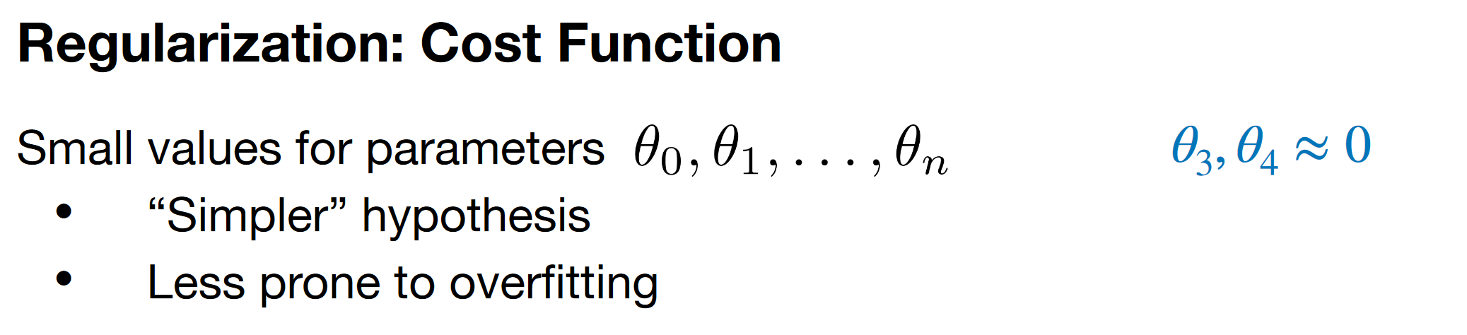
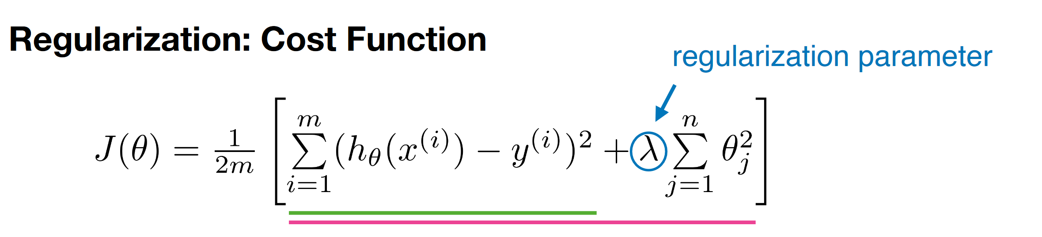
Regularization / Weight decay
Credits to Andrew Ng (Stanford Machine Learning, 2017, cs229)

Slide 28
QUIZTIME

Slide 29
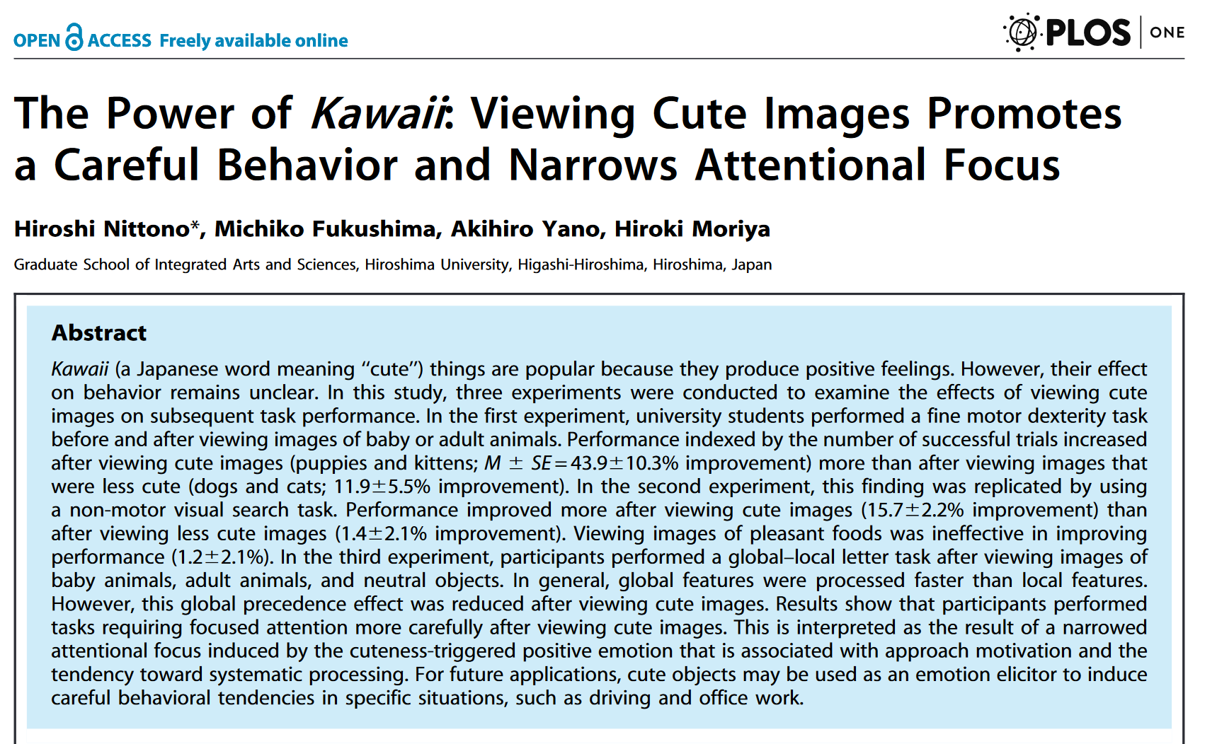

Did you know?
https://journals.plos.org/plosone/article?id=10.1371/journal.pone.0046362

Slide 30
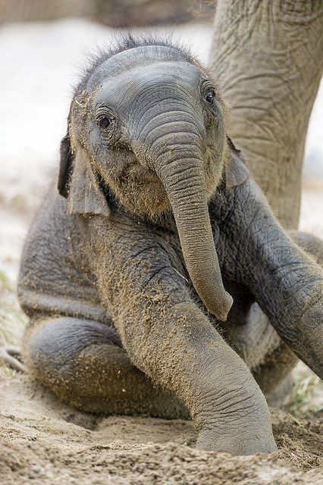
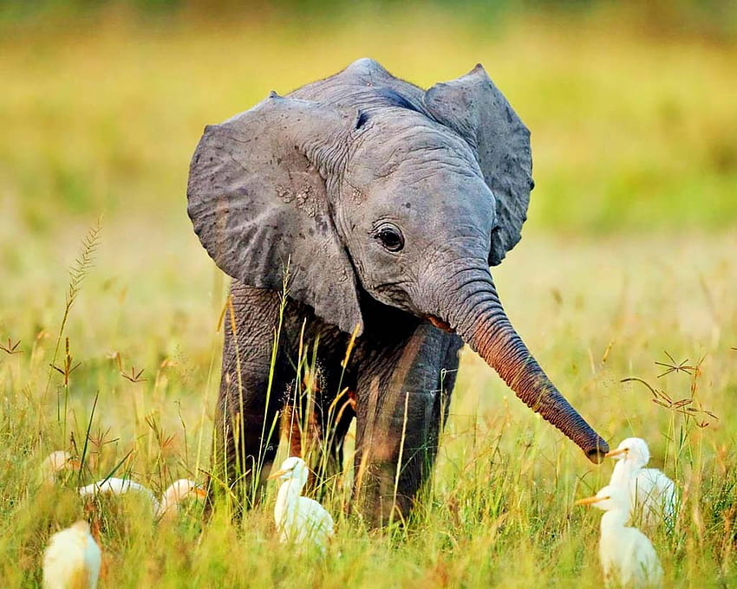
QUIZTIME
https://www.pinterest.co.uk/buzzfeed/
https://www.pxfuel.com/en/desktop-wallpaper-obsks

Slide 31
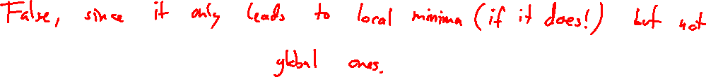
Gradient descent
True or False?
If the gradient descent algorithm converges then it always returns the global minimum of the loss function for different weight initializations.

Slide 32
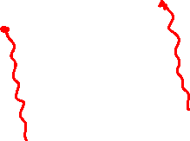
Gradient descent
True or False?
If the gradient descent algorithm converges then it always returns the global minimum of the loss function for different weight initializations.

Slide 33
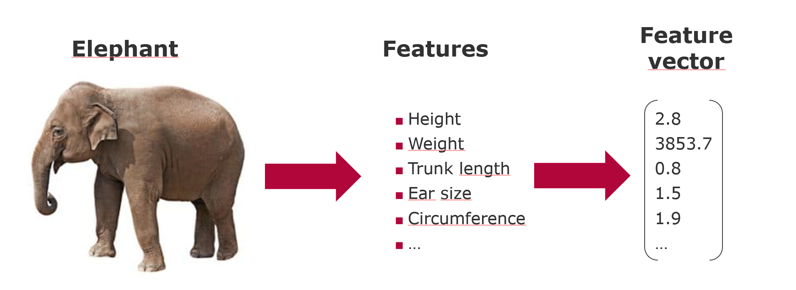
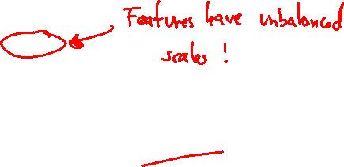
Feature extraction
Question
Consider the following way how the feature vectors are extracted from elephant instances. What could turn out as a problem here?

Slide 34
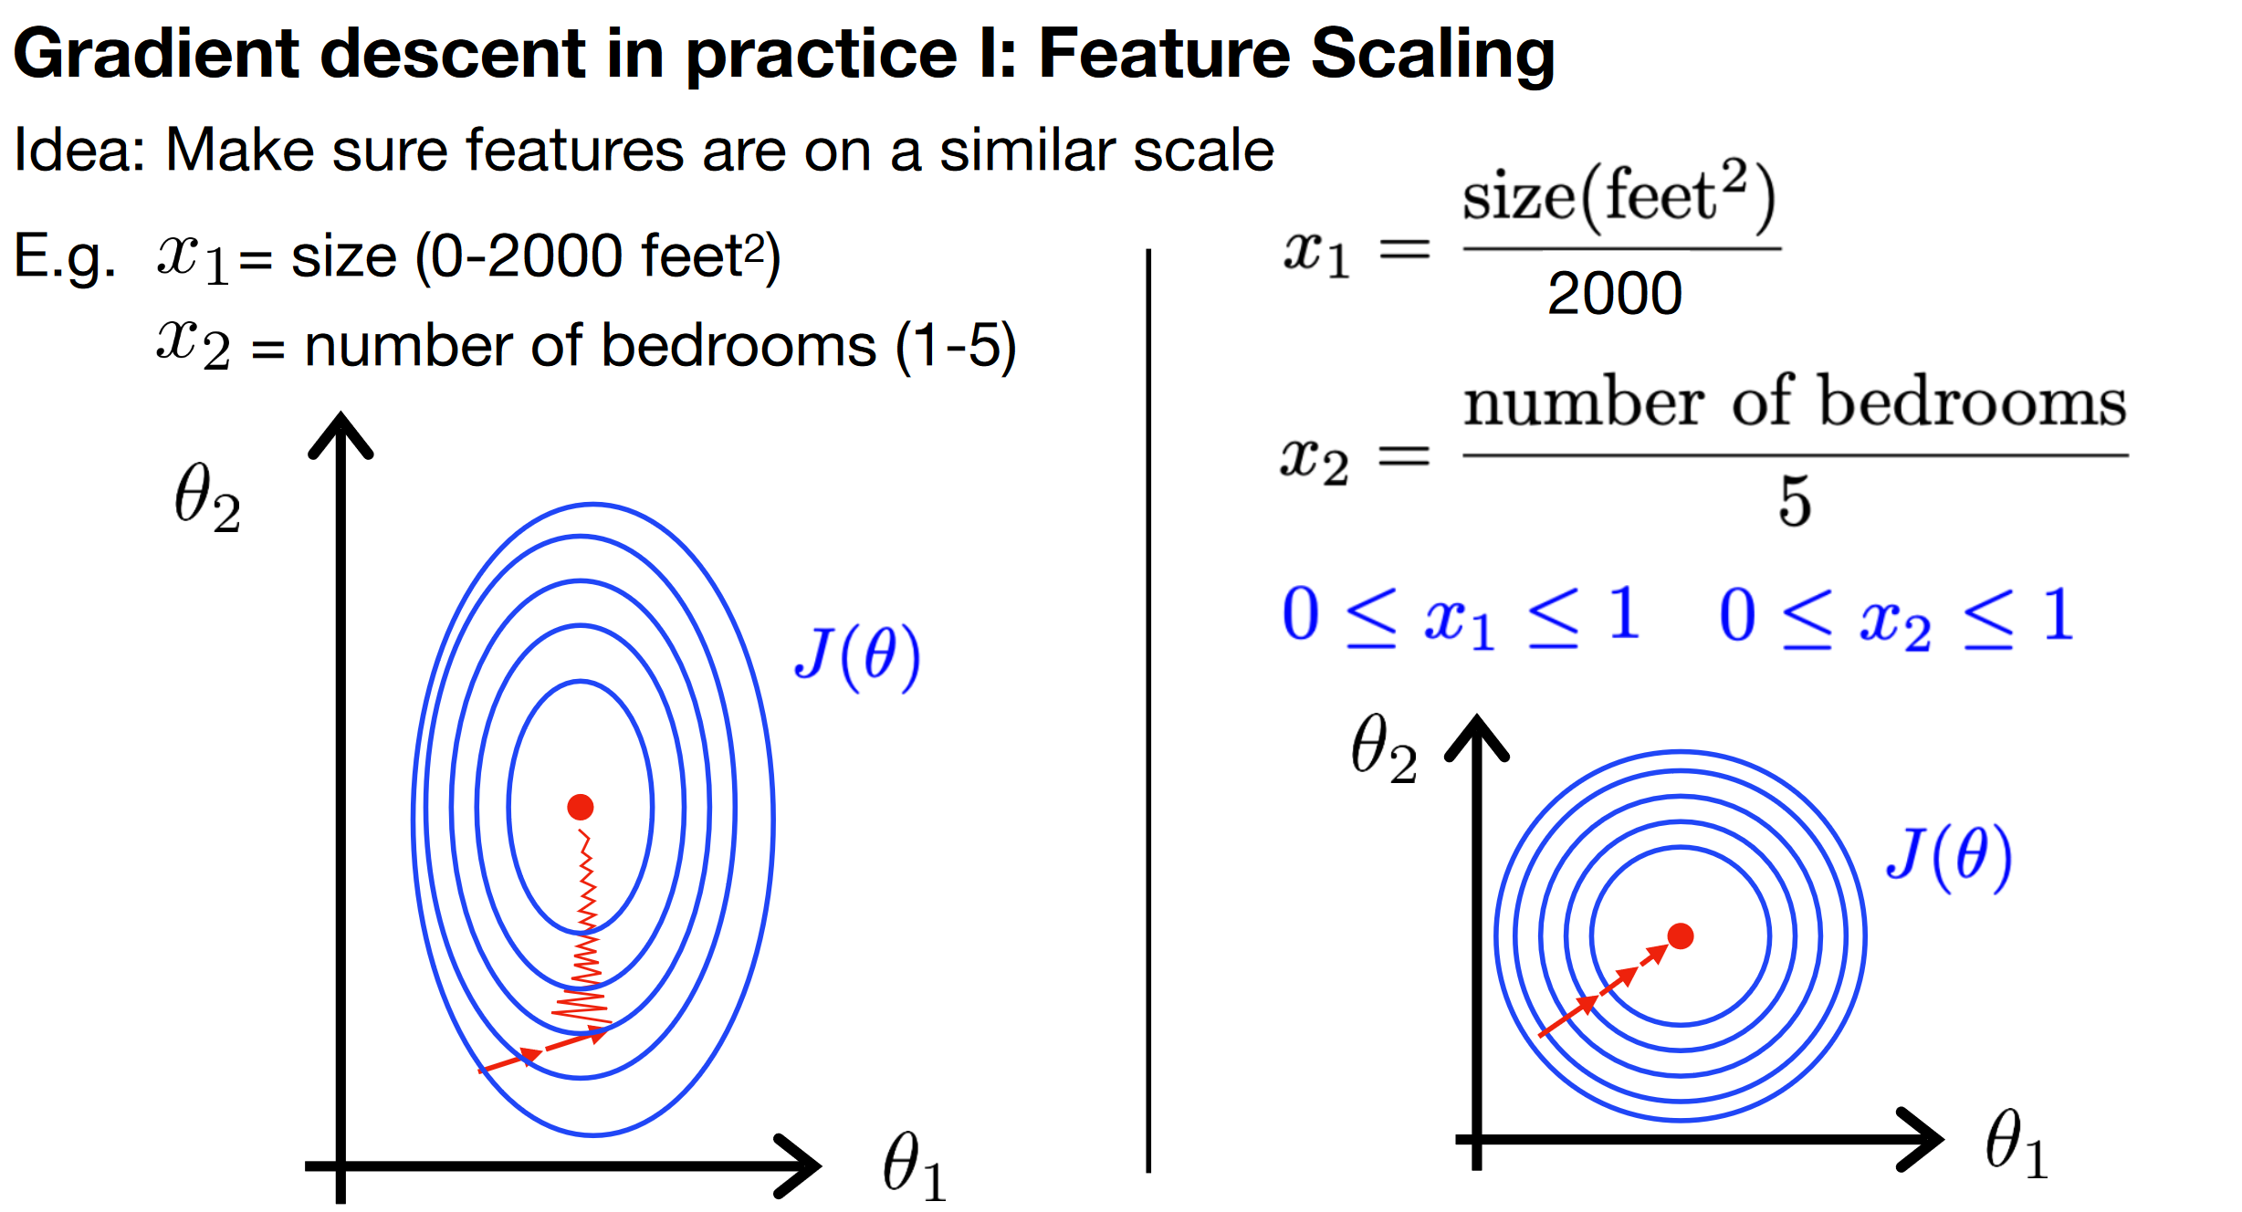
Feature extraction

Slide 35
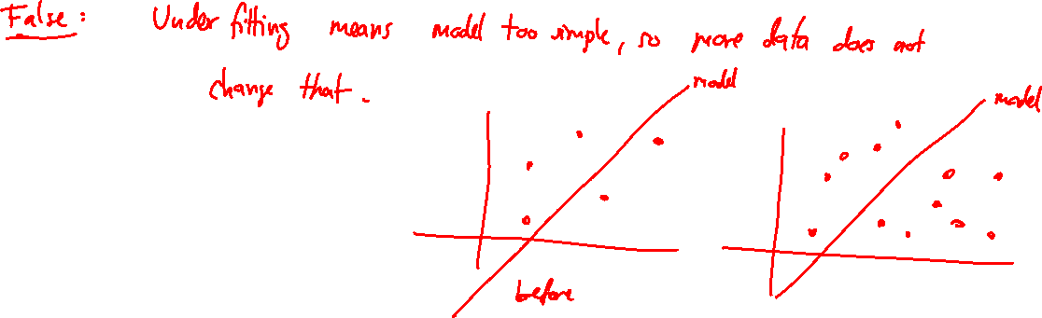
Gradient descent
True or False?
In order to avoid underfitting we should increase the number of training instances.

Slide 36
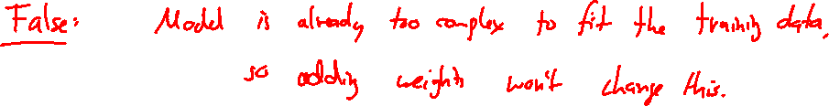
Gradient descent
True or False?
In order to avoid overfitting we should increase the number of learnable weights.

Slide 37
Regularization
True or False?
In order to avoid overfitting, you should increase the regularization parameter.

Slide 38
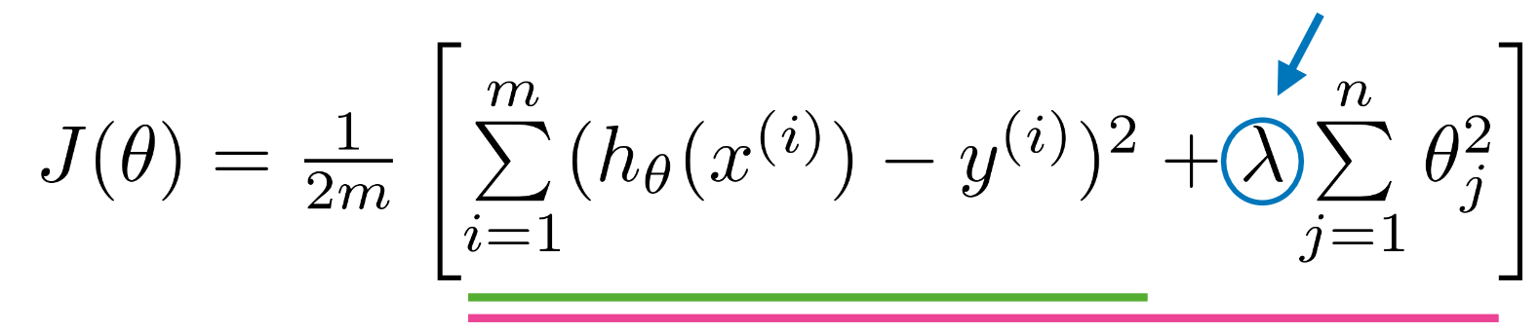
Regularization
True or False?
In order to avoid overfitting, you should increase the regularization parameter.

Slide 39


Learning rate
True or False?
If I increase the learning rate, then the regularization parameter increases as well.

Slide 40
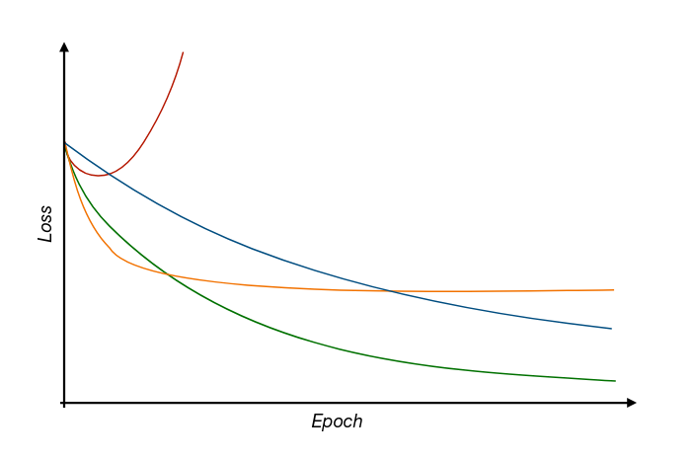
Learning rate
Question
What can be said about the learning rate during these different runs of Gradient Descent based on how the loss function behaves with increasing iterations?
Iterations

Slide 41
Thank you for your attention

